Slide 1
Mycobacterium

Slide 2
Mycobacterium is a genus of Actenobacteria given its own family, the Mycobacteriaceae. Over 190 species are recognized in this genus. This genus includes pathogens known to cause serious diseases in mammals, including tuberculosis (Mycobacterium tuberculosis )
Tuberculosis is a chronic granulomatous disease , The tubercle bacilli are
Mycobacterium tuberculosis the agent of the disease in human and cattel
M. bovis in other mammals
M.avium in birds
The host specificity is relative

Slide 3
Reservoir
The source of tubercle bacilli is tuberculos individuals
1- M. tuberculosis in human and cattel
1- M. bovis in cattel
2- M. avium in chickens
These species can infect wild mammals and birds which occasionally become sources of infection for domestic animals
Transmission
Tubercle bacilli are transmitted via the respiratory and alimentary routes through feces , urine ,genital discharges , milk from infected mammary glands or contaminated feed and water

Slide 4
Laboratory diagnosis. 1. Microscopy of smears from sputum, pus, spinal or pleural fluid, urine, faeces, lymph nodes, etc., stained by the Ziehl-Neelsen method.
Cultivation. The organisms grow on selective media, 1- coagulated serum,2- glycerin agar, 3- glycerin potato,
4- glycerin broth and 5-egg media .6- they may be cultured on synthetic medium which contains asparagine, glycerin, iron citrate, potassium phosphate, and other substances.

Slide 5
The organisms are aerobic, and their optimal growth temperature is 37 C. They do not grow below 24 and above 42 °C. The reaction of the medium is almost neutral (pH 6.4-7.0), but growth is possible at pH ranging from 6.0 to 8.0

Slide 6
Morphology.
1-Gram-positive irregular bacilli
2- Acid-fast staining
3-Produce catalase
5-Possess mycolic acids and a unique type of
peptidoglycan
6-Do not form capsules, flagella or spores
7-Grow slowly
.

Slide 7
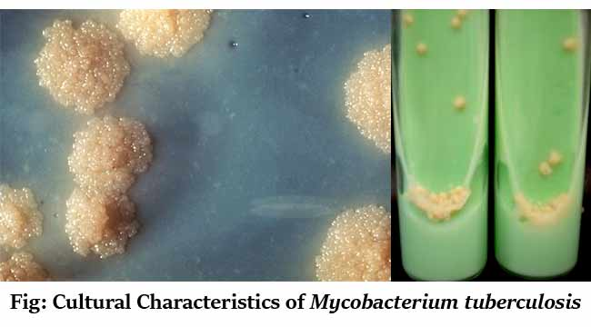

Slide 8
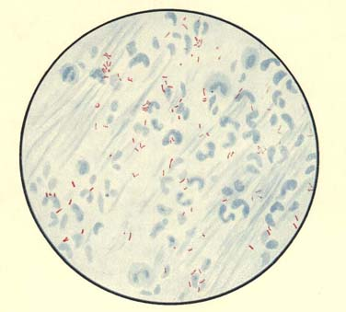
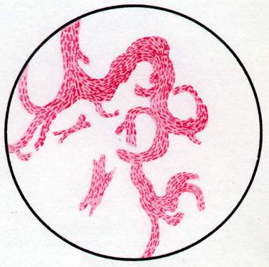
M. tuberculosis

Slide 9
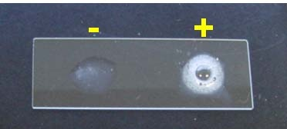
Catalase is a common enzyme found in nearly all living organisms exposed to oxygen . It catalyzas the decomposition of hydrogen peroxid to water and oxygen It is a very important enzyme in protecting the cell from oxidative damage by reactive oxygen species (ROS). catalase has one of the highest turnover numbers of all enzymes; one catalase molecule can convert millions of hydrogen peroxide molecules to water and oxygen each second

